Slide 1
Space Invader
Made by:
Yashar Guzel
Bekzat Zamirbek uulu

Slide 2
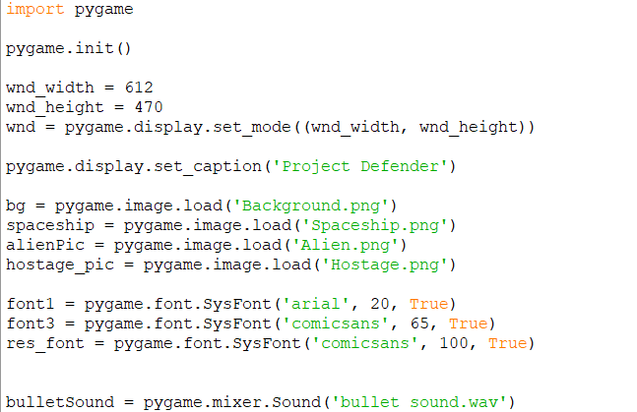
Modules, External Resources

Slide 3
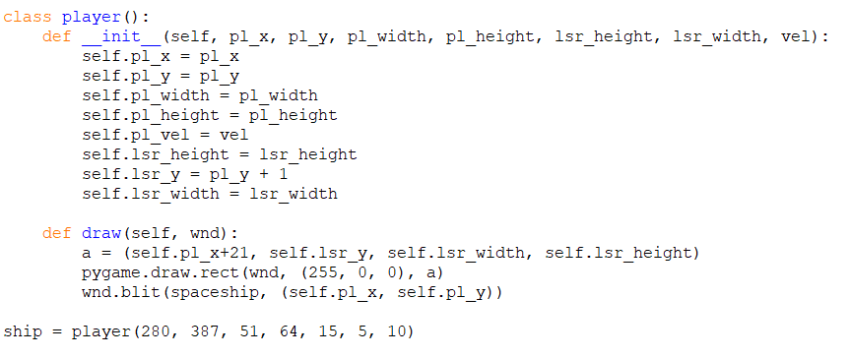
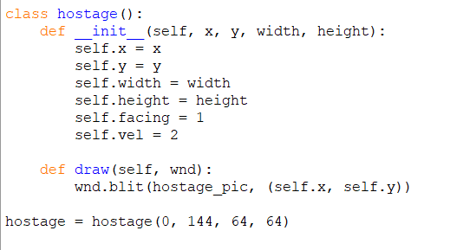
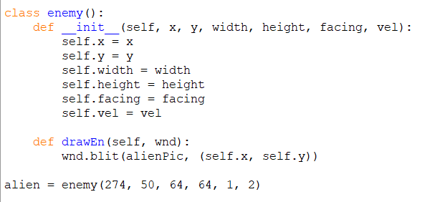
Classes

Slide 4

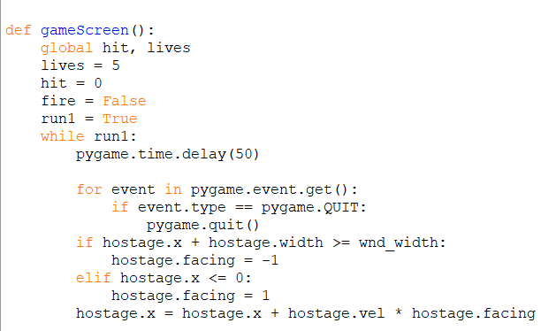
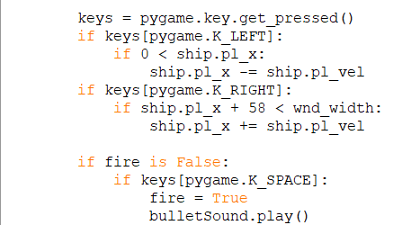
Game Screen 1) Screen Updating, Player Movements

Slide 5
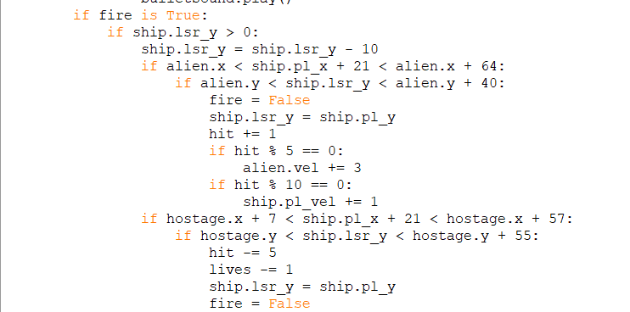
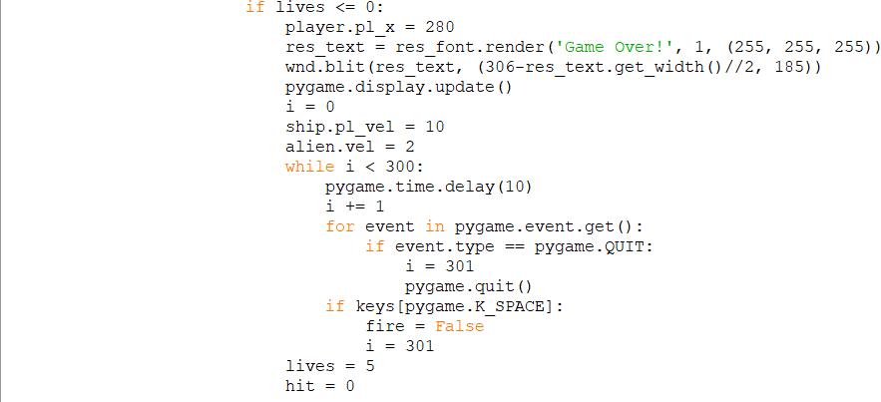
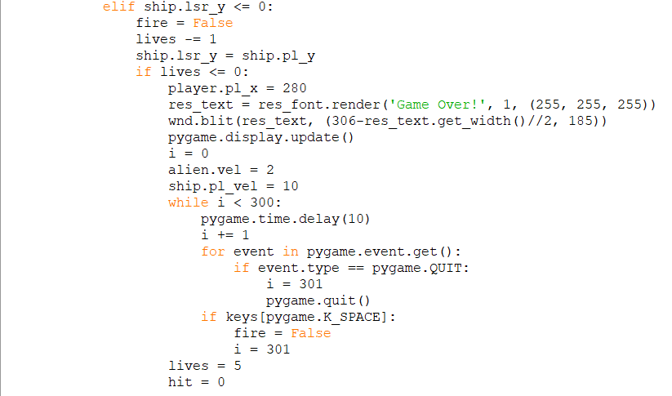

2) Shooting, Game Over!

Slide 6

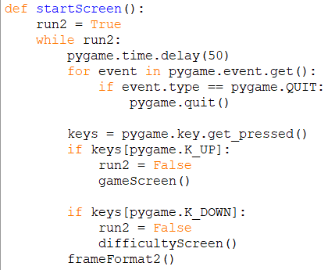
Start Screen

Slide 7
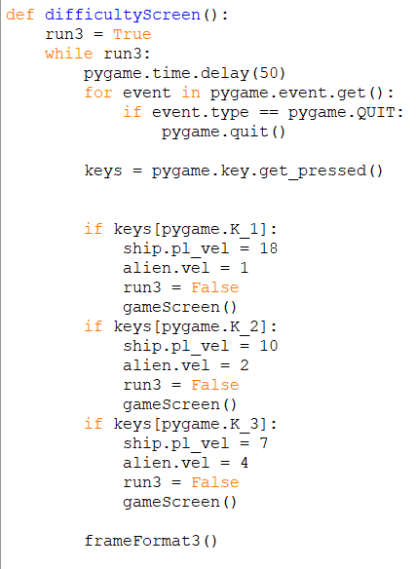


Difficulty Screen

Slide 8
Thank You for your attention!
Thanks from:
Yashar Guzel
Bekzat Zamirbek uulu

